Slide 1
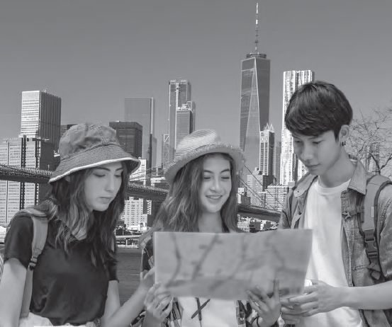
English
Santa Marta School
La Unión, 2020
Ana Navarrete G.

Slide 2
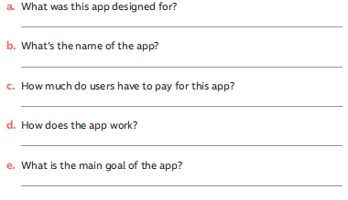
Page 4
It was designed to help blind people explore their world
It is called Lookout
It is free
It uses a device’s camera to recognize text and objects and then provide voice descriptions about what it sees.
It is to provide more independence to the nearly 253 million people in the world who are blind.

Slide 3
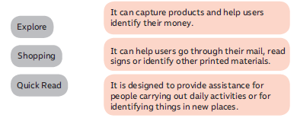
Page 4

Slide 4
Page 4
Microsoft’s free Seeing AI
Be My Eyes

Slide 5
Page 5
I use it a lot because I love playing games and listening to music
A little time, a year ago

Slide 6
Page 5
My smartphone is the electronic device I use the most because I can do all the things and stuffs related to my student life
I can do research, work in groups with my friends, send text messages, upload videos, pictures, voice calls.
I can entertain myself when I’m alone listening to music or watching videos or browser in social media

Slide 7
Page 6
descargar
eliminar
subir

Slide 8
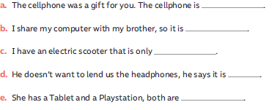
Page 6
yours
ours
mine
his
hers

Slide 9
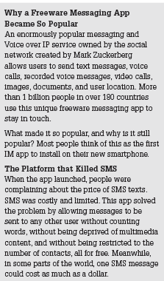
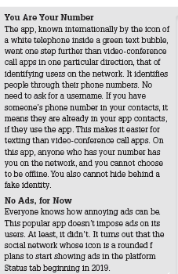
Page 7

Slide 10
Page 7
They are free
They do not require data or data fees
They can be used on any smart device

Slide 11
Page 7
Lanzado
(para uso público)
reclamo
Identidad falsa

Slide 12
Page 8
That pencil is mine. Give it to me!
Show me yours and I’ll show you mine
That skirt of hers is really indecent!
It is interesting to compare their situation and ours
Whose mobile phone is this? It’s his

Slide 13
Page 8
I agree, there are apps which allow strangers to get in touch, allow kids to send self destructing photos or videos, let users interact anonymously, can get into conversation with people you don’t know
It’s because it has the potential of being seen by anyone on the internet and it uses up the phone battery quickly
I agree. They have to know where you are, to pick you up

Slide 14
Page 9

Slide 15
Page 9
Yes, I have seen the movie
It was Phillips Exeter Academy, a pre school where he graduated in 2002
Because it published its own student directory «the photo address book», and this is now known as facebook

Slide 16
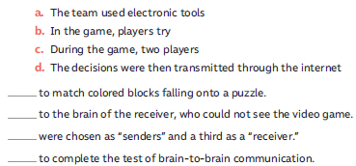
Page 12
b
d
c
a

Slide 17
Page 12
It is the first experiment they have made of this type
This game is the simple version of the Tetris game, extremely popular in the 90’s
There could be the possiblity to solve human problems by connected brains, in the future

Slide 18
Page 13
Stories telling through social media
Few lines of text used to explain or elaborate on published photographs
Label for content. It helps others who are interested in a certain topic, quickly find content on that topic

Slide 19
Page 13
You should use your own images if possible
Don’t upload photos with plenty of information about yourself. Privacy is always important
Don’t compromise your security when you publish pictures in your house

Slide 20
Page 14
3
1
4
2

Slide 21
Page 14
connect
send
download

Slide 22
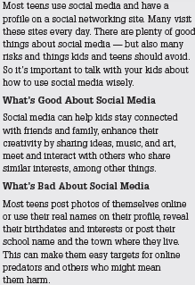
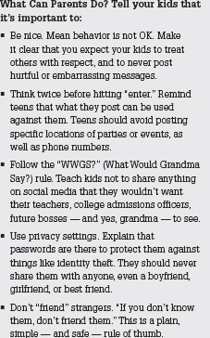
Page 15

Slide 23
Page 15
You shouldn’t post hurtful or embarrasing messages
You should avoid posting specific locations of parties or events as well as phone numbers

Slide 24
Page 15
I agree in avoiding posting personal information
I agree in avoiding sharing passwords

Slide 25
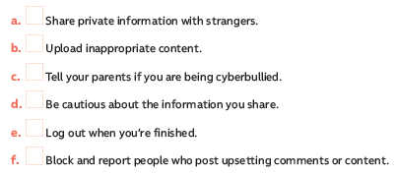
Page 16

Slide 26
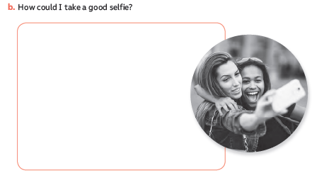
Page 16
Self taken camera picture
-Natural lighting
-Avoid shadows ( sunrise or sunset)
-Know when to use flash ( dark areas)
-Smile

