Slide 1
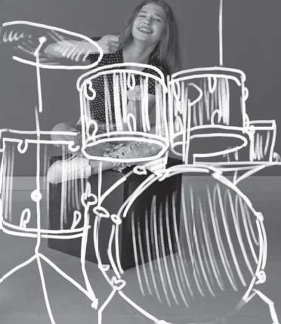
English
Santa Marta School
La Unión, 2020
Ana Navarrete G.

Slide 2
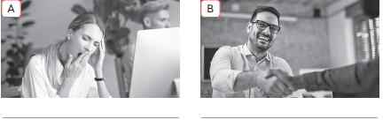
Page 4
bored
happy
tired
sad

Slide 3
Page 4
happy
bored
tired
sad

Slide 4
Page 4
I feel sad when I don’t answer when I don’t answer correctly a test
I feel tired when I don’t sleep enough at night
I feel happy when I visit my grandparents at the countryside

Slide 5
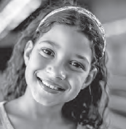
Page 5
When people ask what my favorite movies
are, they are surprised / bored that I answer
animated movies, no doubt! I just love / hate
them. I really enjoy / dislike watching Shrek
over and over again. It’s hilarious!... Oh, and
my favorite animated movie is Ratatouille. If
you ask me about movies I can’t stand / prefer,
I would say horror movies… most of the time I
know exactly how they will end… and I don’t
understand the point of getting scared in your
free time!

Slide 6
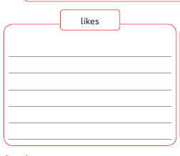
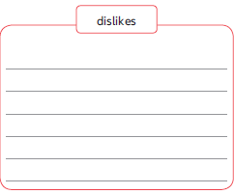
Page 5
On Saturdays I like to seep later and love sending messages to my friends. I also like eating pizza nd hamburgers but I prefer eating empanadas. All the family enjoy eating this homemade food
I don’t like getting up early on Sundays. I hate eating beans at lunch and I can’t stand tidying my room

Slide 7
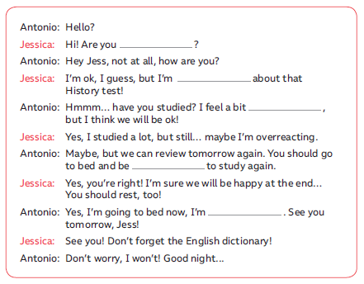
Page 6
busy
anxious
worried
well rested
tired

Slide 8
Page 6
I feel annoyed when I get bad results at school
I feel anxious when I have to speak in public
I feel relaxed after a yoga class
I feel delighted when I travel abroad

Slide 9
Page 7
I’m really afraid of horror movies
We couldn’t get into the concert, so I was a bit annoying
I’m super worried about my father’s health
Don’t be so mean and help your friends
I feel very lucky to have a friend like you

Slide 10
Page 7
First, I selpt until 9 and got out of bed to
shower
Second, I thought nobody remembered my birthday, but surprise! I was really happy
when I saw a present my mom left me on the kitchen table
Then, I opened it
Next, my brothers came to hug me
Finally I was very happy and about my family. Iand I thought to myself how lucky I am!

Slide 11
Page 7
Hi, I’m Paul, and this is my daily routine.
First, I get up at 7am, take a shower and brush my teeth. I go to school by 7:40. I don’t take a bus because I walk with a friend from school. We usually have breakfast there. Then, we have lunch at around 1:45. My favorite dish is lentils! We finish school at 4:15. I walk back home and clean my room. After that, I do my homework
or study for an hour or two. I don’t study the same subjects everyday. Then, at around 7:00 I have dinner with my family. I don’t like to have dinner late because if I do so I don’t sleep well. I usually go to bed at 10:00. That is what I generally do on a normal day!

Slide 12
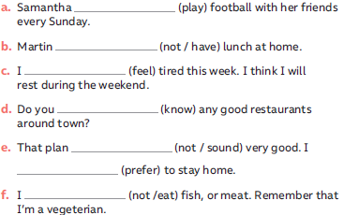
Page 8
plays
doesn’t have
feel
know
doesn’t sound
prefer
don’t eat

Slide 13
Page 8
I get up at 10, then I take a shower and to go to the kitchen for my breakfast. Then I help my mum. After that a I play computer games or send messages to my friends

Slide 14
Page 9
I agree I think teenagers need to move their bodies and need to share with friends outdoors in the real world. It’s healthier than stay inside sitting on a chair in front of a tv
Yes, because you can experience fraudulent credit card charges, your email accounts can be hacked, someone else can take control of your social media account

Slide 15
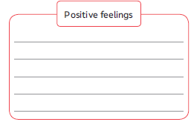
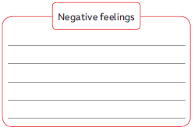
Page 9
lucky
delighted
friendly
happy
confident
relaxed
mean
terrified
annoyed
afraid
anxious
bored

Slide 16
Page 13

Slide 17
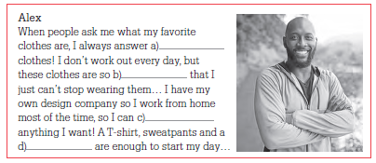
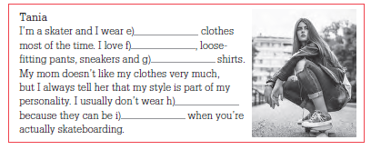
Page 14
sporty
comfortable
wear
hoodie
skater
beanies
loose
accessories
uncomfortable

Slide 18
Page 14
The style I like the most is sporty, because I love doing sports and these clothes are very comfortable. You can move freely

Slide 19
Page 14

Slide 20
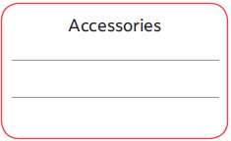
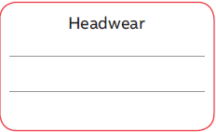
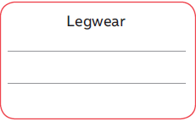
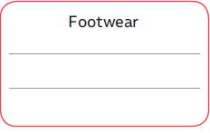
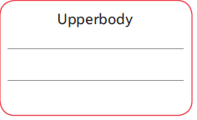
Page 15
wristband, studded belt,
hoodie, beanie, cap, headband
bracelet, necklace
dress, short-sleeved t-shirt, jacket.
Threequarter length shorts,
tight jeans, khaki pants, leggings
sneakers, sandals, socks

Slide 21
Page 15
comfy
beanie
bargain
inexpensive
baggy clothes

Slide 22
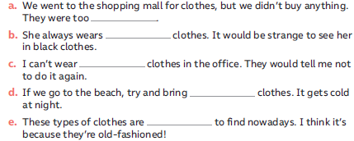
Page 15
expensive
colorful
sporty
warm
difficult

Slide 23
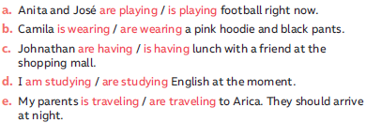
Page 16
Don’t forget
I am you are
He is They are
She is We are
It is

Slide 24
Page 16
Hi today It’s Sunday so I am wearing comfortable clothes
When I’m not at school I love wearing sporty clothes
I am wearing a pink hoodie, black sweatpants and sneakers

Slide 25
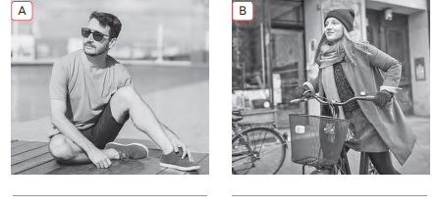
Page 16
He is wearing sunglasses,
a loose short sleeved
t-shirt and sneakers
She is wearing a sweater, a skirt and black gloves, a scarf and a beanie as accessories

Slide 26
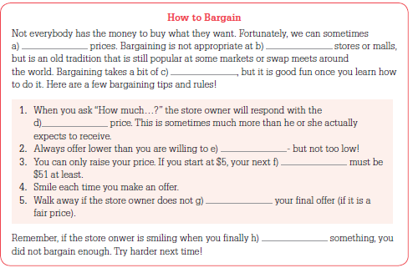
Page 17
negotiate
regular
practice
starting
pay
offer
accept
buy

Slide 27
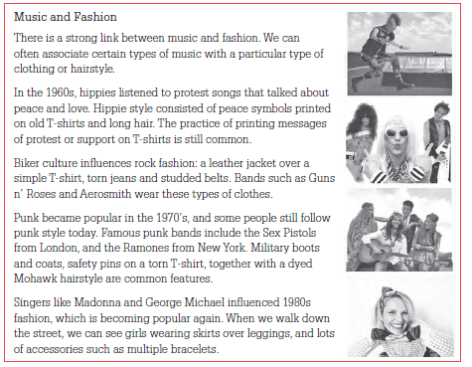
Page 18

Slide 28
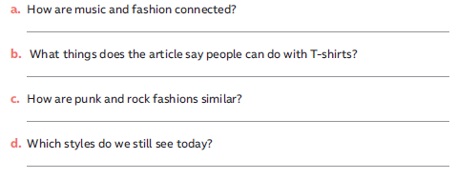
Page 18
They are connected to a particular type of clothing or hairstyle.
Peace symbols printed on old T-shirts, protest or support messages, and put safety pins on a torn t-shirt.

